Slide 1
Image inpainting: gan vs diffusion models
Saghar Ghaffari & Ana María Jaramillo

Slide 2
Image inpainting
reconstruction of missing portions of an image based on contextual background information
Image Restoration
Image Enhancement
Notes:
Photo Restoration: Restoring old or damaged photographs.
Medical Imaging: Completing missing or obscured parts in medical images.
Object Removal/Replacement: Editing images for aesthetic or privacy reasons.
Video Processing: Ensuring smooth transitions in video frames.

Slide 3
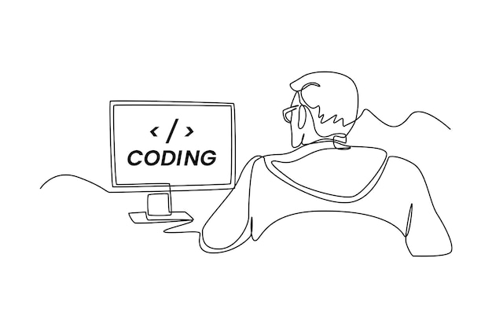
implementation

Slide 4
gan

Slide 5
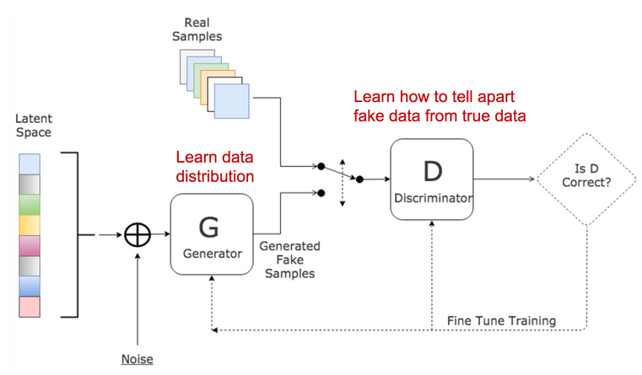
architecture
Dataset: Places365
Notes:
3. Introduction to GANs:
Briefly introduce GANs as a class of generative models consisting of a generator and a discriminator.
Explain the adversarial training process where the generator learns to generate realistic images, and the discriminator learns to distinguish between real and generated images.
4. GANs in Image Inpainting:
Discuss how GANs are applied to image inpainting:
Generator: Generates realistic and coherent content for the inpainted region.
Discriminator: Ensures the inpainted region blends seamlessly with the original image.

Slide 6
Build generator:
Fully connected NN (keras)
3 layers
LeakyReLU Activation
Batch normalization
Optimizer: Adam
Loss: MSE
- Automatic reading (based on pixel differences)
- Image pre-processing
128 x 128 pixels
- Normalization
- Split dataset
START
Input: Image Output: image
Build discriminator:
Fully connected NN (keras)
2 layers
LeakyReLU Activation
Sigmoid: Classification (Real / fake)
Optimizer: Adam
Loss: binary crossentropy
Repair generator: trained to restore a damaged image.
Input: original image and the damaged image.
Output: produced repaired image.
Generator: trained to generate realistic images from random noise
Discriminator: trained to distinguish between authentic and generated images.
Input: Image Output: single neuron
Notes:
For the generator, a simple, fully connected neural network was developed. It has three layers of increasing size and a final layer of the same size as the input image. The input to the generator is a random noise vector with a defined size. The activations between the layers use the LeakyReLU activation function, which is known to be beneficial for GANs. Batch normalization is also used between the layers to normalize the activations and improve training stability. Finally, the output layer uses the hyperbolic tangent activation function (tanh) to ensure that the output is in the range of [-1, 1], which is typical for image data.
Architecture:
The generator architecture is implemented using a sequential model in Keras. It consists of fully connected (dense) layers with leaky rectified linear unit (LeakyReLU) activations and batch normalization.
LeakyReLU Activation:
LeakyReLU allows a small, non-zero gradient when the input is negative, preventing the saturation of neurons during training.
Batch Normalization:
Batch normalization layers are added after each LeakyReLU activation. Batch normalization helps stabilize and accelerate training by normalizing the input of each layer.
Output Layer:
The final layer of the generator is a dense layer with a hyperbolic tangent (tanh) activation function. This layer produces the generated image data. The activation function is chosen to ensure that the output values are in the range [-1, 1], suitable for image data.
Reshape Layer:
A reshape layer is added to transform the output of the generator into the desired image shape. The shape of the generated image is assumed to be specified by the variable img_shape.
EXPLAIN: This is because the repair generator is responsible for producing the repaired images, which are then evaluated along with the generated images during training. Without the repair generator, the GAN would not be able to evaluate the quality of its repairs, and it would not be able to improve its performance in repairing images.

Slide 7
Diffusion model

Slide 8
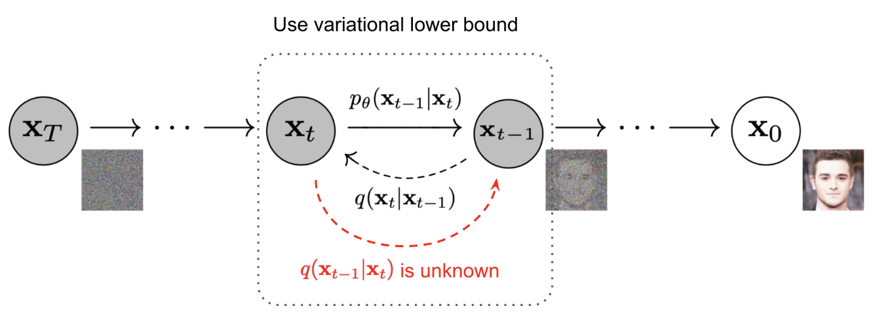
architecture
Notes:
6. Introduction to Diffusion Models:
Introduce diffusion models as a class of generative models that model the pixel-wise diffusion process.
Explain that diffusion models iteratively update pixel values, gradually revealing the complete image.
7. Diffusion Models in Image Inpainting:
Discuss how diffusion models are applied to image inpainting:
Step-wise Diffusion: Gradually reveal missing information through iterative steps.
Noise Model: Capture complex image structures through a diffusion process.

Slide 9
Definition of diffusion process using TensorFlow Probability.
Input: Tuple of undamaged and damaged images.
Returns: output after simulating the diffusion process.
- Automatic reading (based on pixel differences)
- Image pre-processing
128 x 128 pixels
- Normalization
- Split dataset
START
Process of adding noise to afterwards denoise
Learn the process
Build de model Optimizer: Adam
Loss: MSE

Slide 10
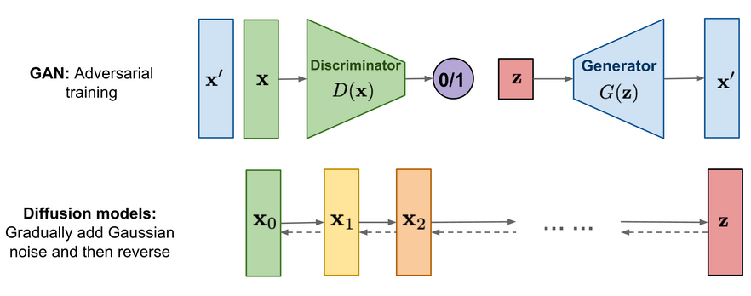
Side by side

Slide 11
results

Slide 12
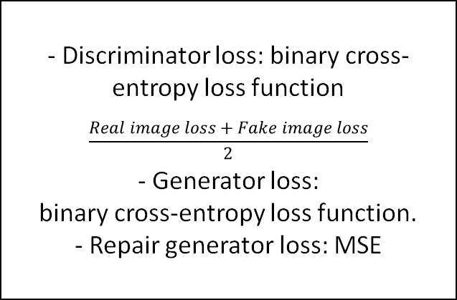
loss
GAN
DIFFUSION MODEL
- Discriminator loss: binary cross-entropy loss function
$$\frac{Real image loss+Fake image loss}{2}$$
- Generator loss:
binary cross-entropy loss function.
- Repair generator loss: MSE
MSE
Notes:
GAN: discriminator loss, generator loss, and repair generator loss. The discriminator loss is calculated using the binary cross-entropy loss function. This results in two separate loss values, one for the real images and one for the fake images, which are then averaged to obtain the final loss value for the discriminator. The generator loss is calculated using the binary cross-entropy loss function. The generator loss is minimized to improve the ability of the generator to generate realistic images. The repair generator loss is calculated using the MSE loss function. The repair generator is trained to reconstruct undamaged images from their damaged counterparts by minimizing the difference between the repaired and undamaged images.

Slide 13
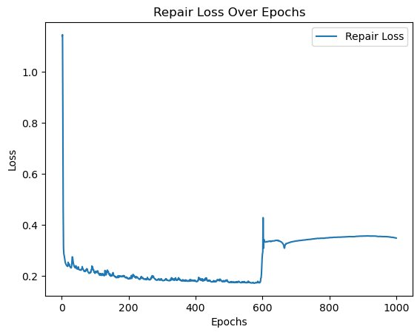
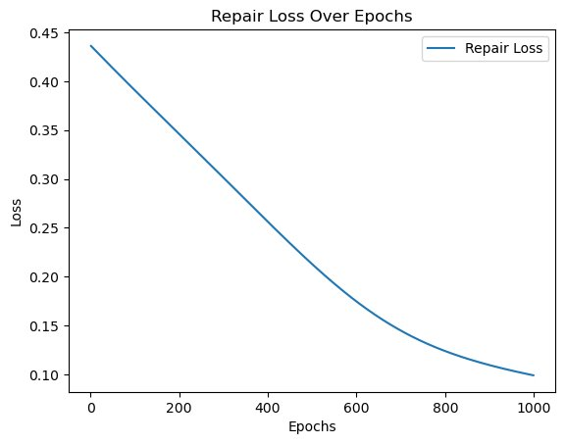
GAN Loss Function over epochs
Diffusion Loss Function over epochs

Slide 14
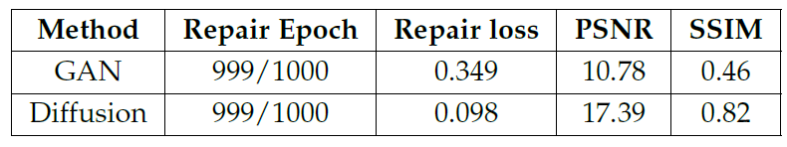
metrics
Peak Signal-to-Noise Ratio (PSNR) is a metric used to measure the quality of reconstructed images, which focuses on pixel-wise reconstruction accuracy [2] [4].
Structural Similarity Index (SSIM) is a pixel-level objective metric for measuring image distortion.

Slide 15
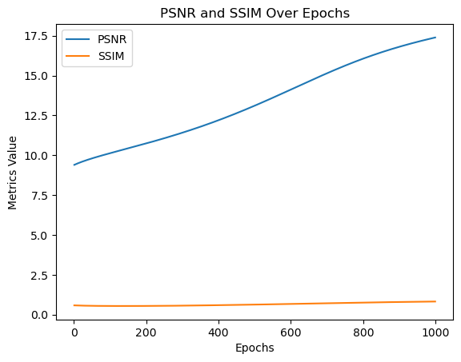
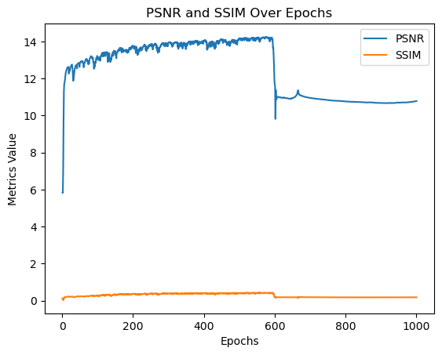
GAN PSNR & SSIM over epochs
Diffusion PSNR & SSIM over epochs

Slide 16
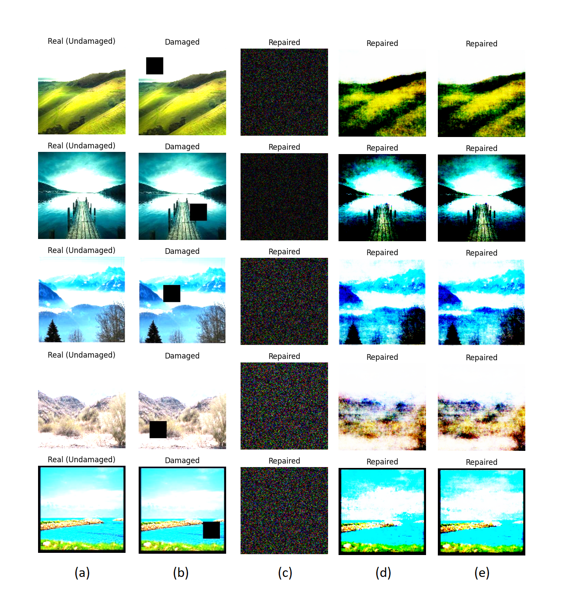
gan

Slide 17
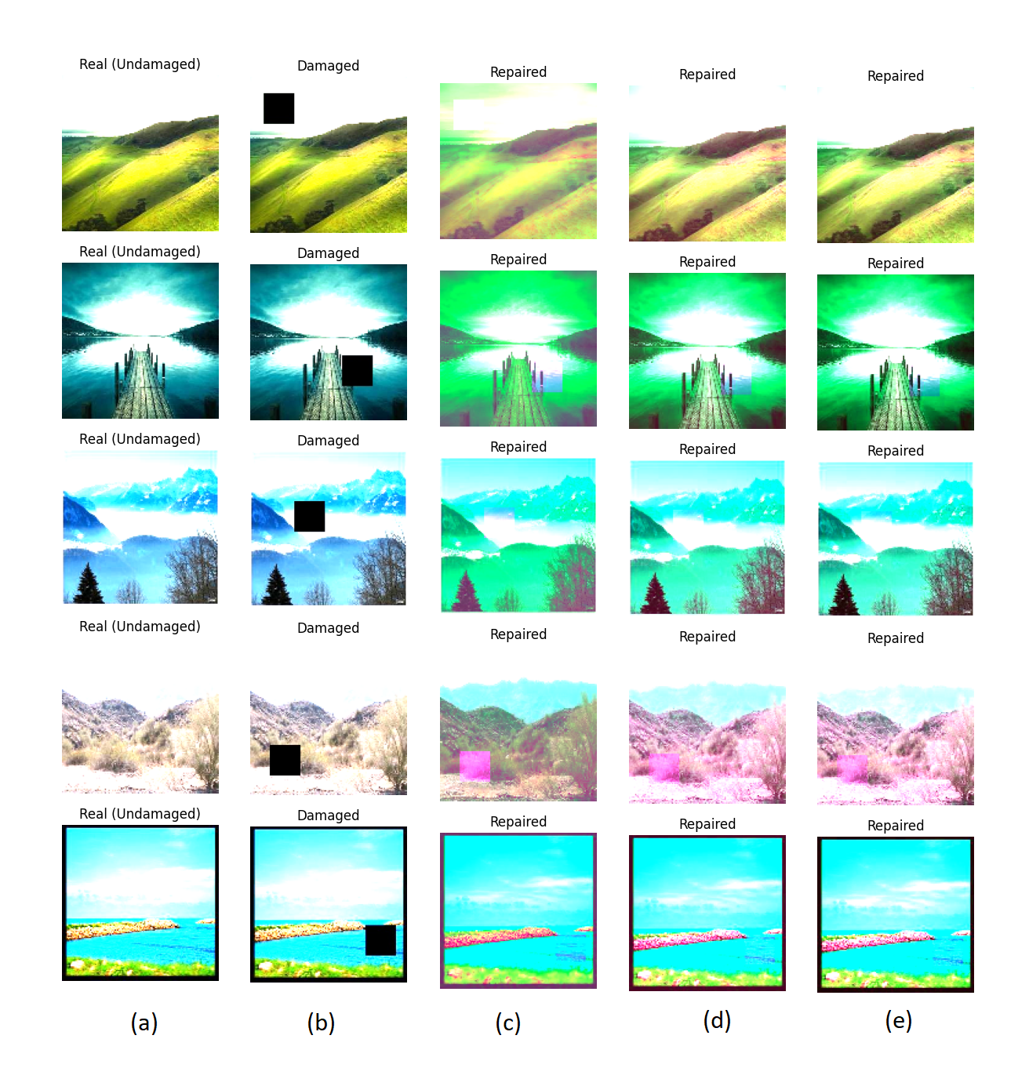
Diffusion model

Slide 18
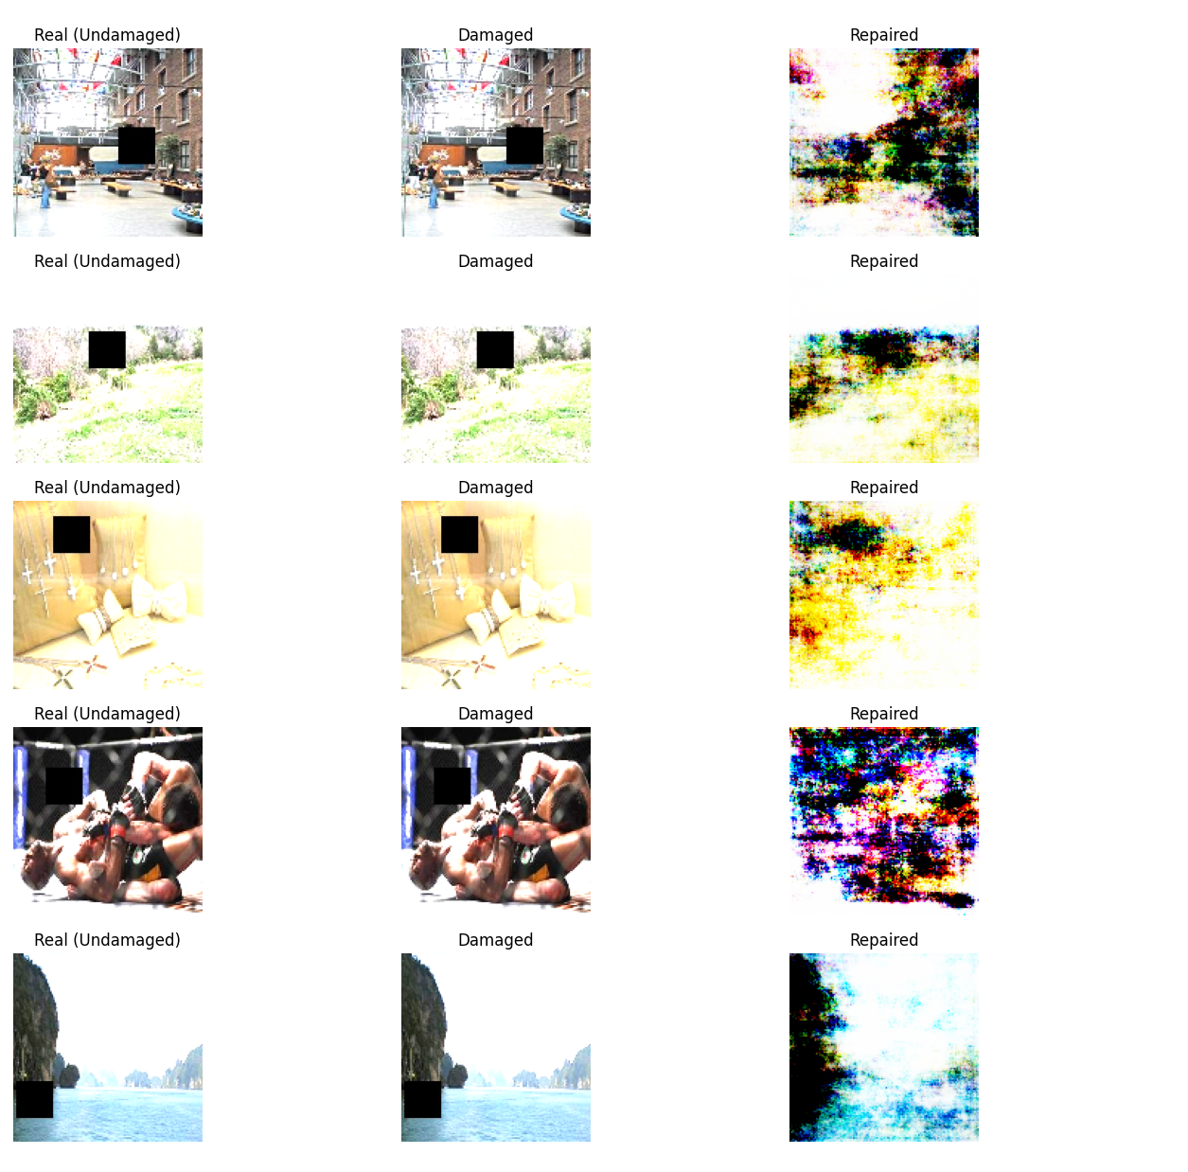
TEST FOR GAN

Slide 19

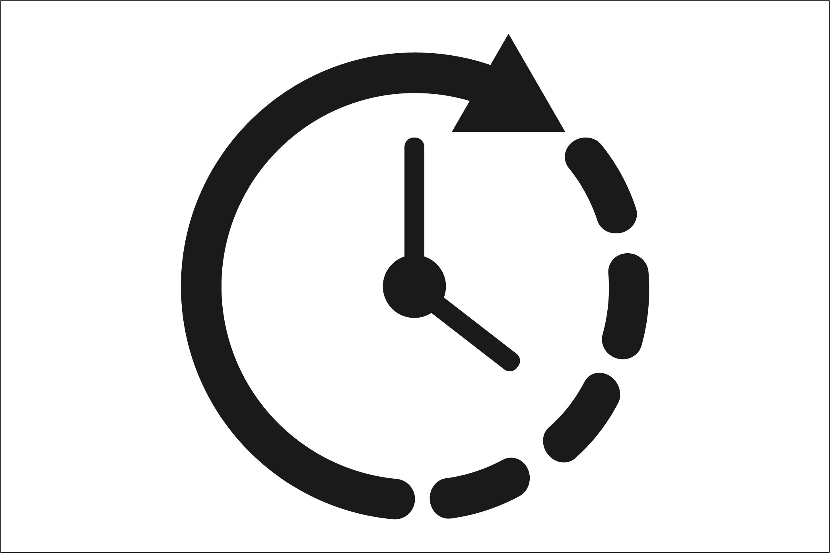
comparison
$
Computational resources
Resulting
generation QUALITY
Training time

Slide 20
SUMMARY
After an analysis of the results, we have found that diffusion models show significant quantitative and qualitative improvements in image inpainting. This approach has outstanding generative capabilities and can effectively capture the compositional structure of images.
Diffusion models produce high-quality images for the inpainting processes, which costs high computational power and longer training times [2].
In contrast, GAN-based models are efficient, leading to a faster result but trading it with the resulting quality of the generated image, which is supported by [3].
Notes:
Highlight the strengths of GANs in capturing complex image patterns.

Slide 21
THANK YOU
Saghar Ghaffari
edughasag001@fh-kaernten.at
Ana María Jaramillo
edujarana001@fh-kaernten.at

Slide 22
references
[1] A. Muhammad, K. Lee, C. Lim, J. Hyeon, Z. Salman, and D. Han, “Gan vs diffusion: Instance-aware inpainting on small datasets,” in 2023 International Technical Conference on Circuits/Systems, Computers, and Communications (ITC-CSCC). IEEE, 2023, pp. 1–5.
[2] L. Weng, “What are diffusion models?” lilianweng.github.io, Jul 2021. [Online]. Available: https://lilianweng.github.io/posts/2021-07-11-diffusion-models/
[3] A. Burak Yildirim, V. Baday, E. Erdem, A. Erdem, and A. Dundar, “Inst-inpaint: Instructing to remove objects with diffusion models,” arXiv e-prints, pp. arXiv–2304, 2023.

